Slide 1
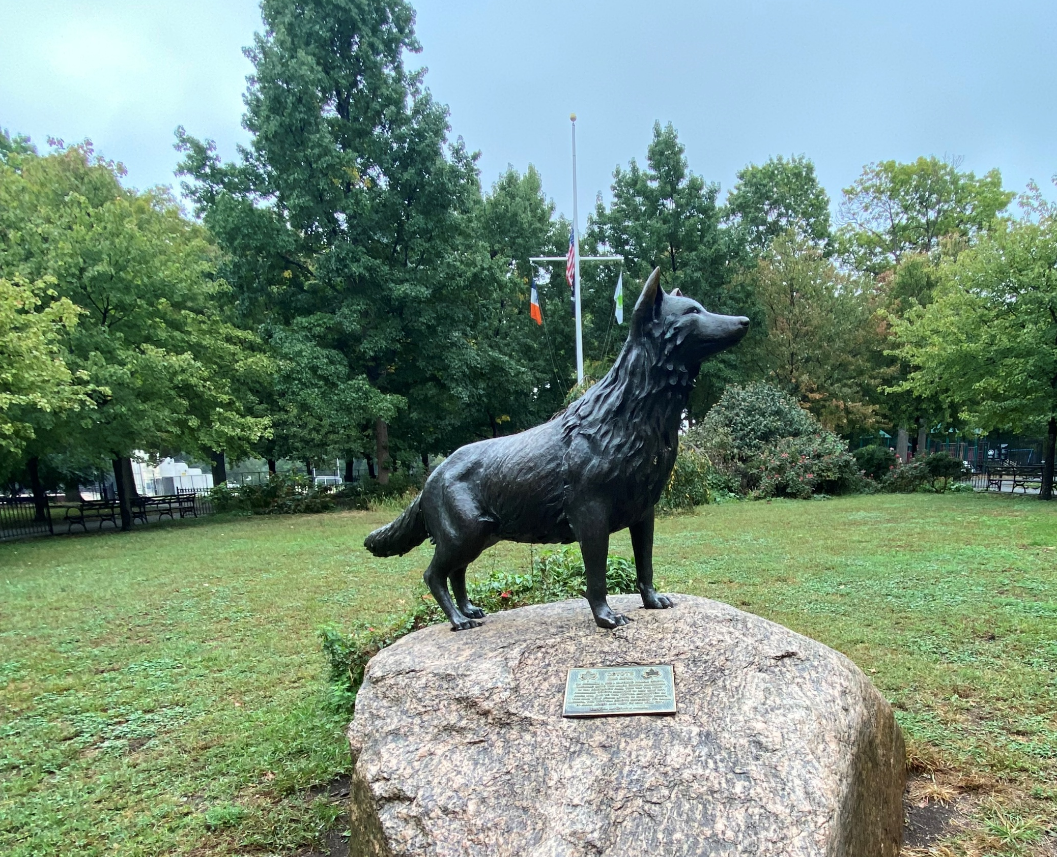
Expansion Across America and Beyond
Canis Latrans
The Adaptable : The Trickster : The Coyote
Van Cortlandt Park coyote statue
Donald Weir NewForce C11 MountWest 2025
Notes:
“Coyotes began as western animals — open ranges, predictable habitats, clear boundaries.
Now they occupy almost every region in the country, often in places we never planned to share.
This presentation traces how their range expanded, what the data actually shows, and how their story is tangled up with ours — because we don’t just live beside them; we’ve helped shape the conditions that let them thrive.”
The coyote honored by the Bronx statue arrived in New York City in 1998, when it was first sighted in Van Cortlandt Park.

Slide 2
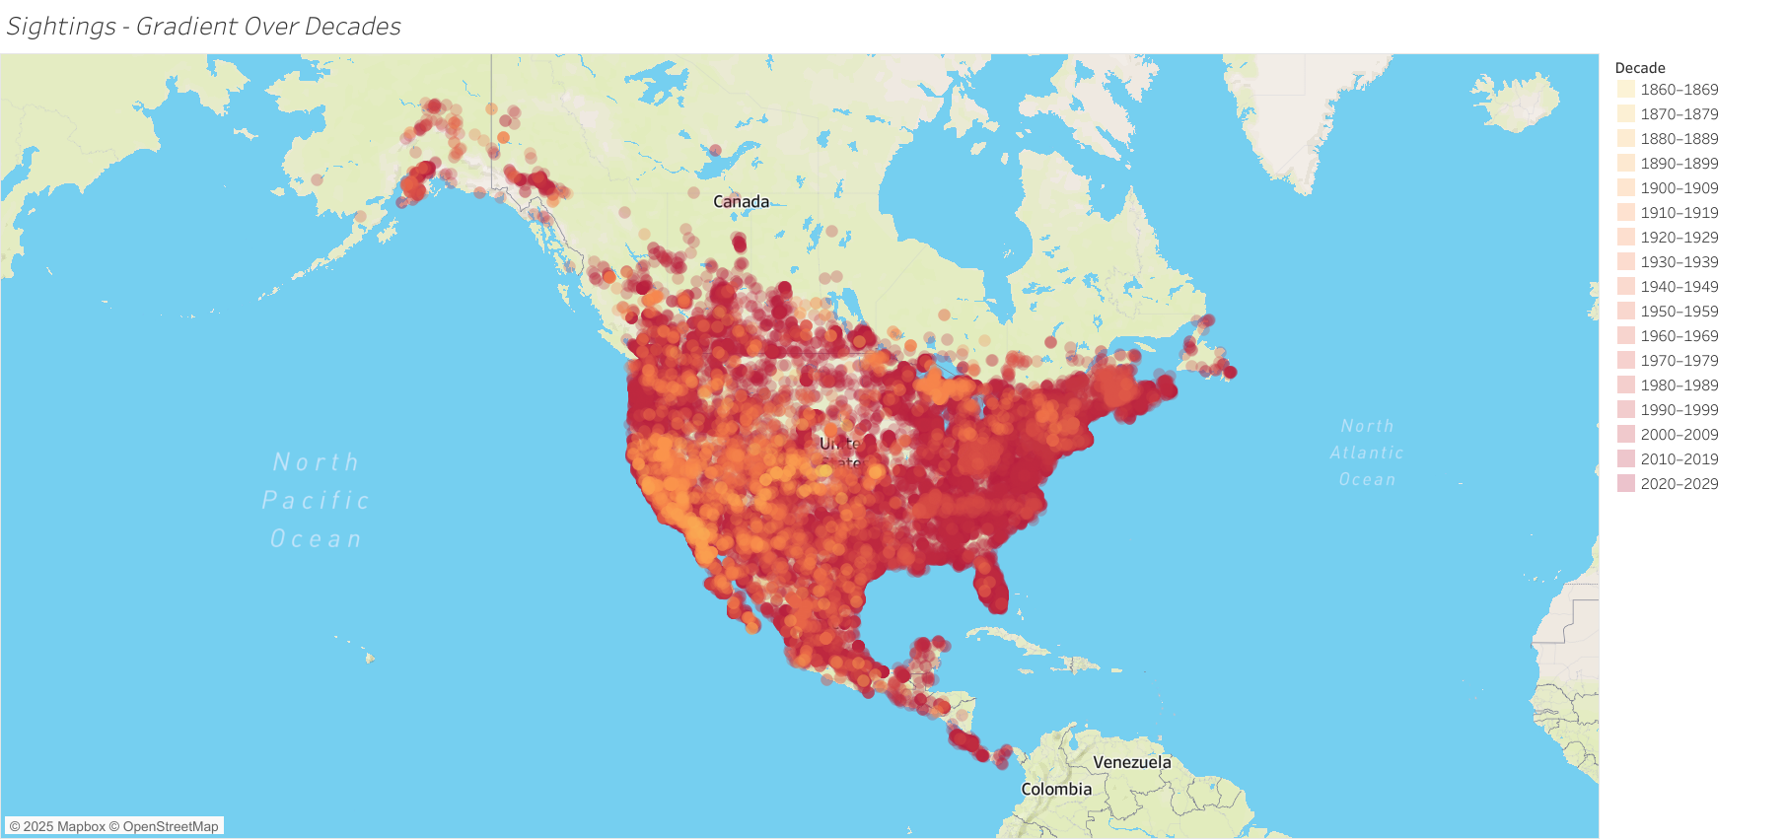
Executive Summary & Guiding Questions
Continental Expansion
Once restricted to the American West, coyotes now span to nearly every ecosystem.
Adaption & Resilience
How do the important periods from 1920 to the present reflect shifts in habitat, monetary impact, and data trends?
How geography, data, and adaptation intersected to redefine this species’ range and relationship with people.
Patterns to Explore
Notes:
“Over roughly two centuries, coyotes adapted to forests, farms, suburbs, and cities.
They changed as the land changed, not as a side note, but as a direct response to what we did with that land.
So the questions here are: *Where did they go, why was their strategy so successful, and what does coexistence look like when both people and wildlife are trying to protect their own survival and their own livelihoods?*
It’s not a story with clear heroes and villains — it’s a story about living together under pressure.”

Slide 3
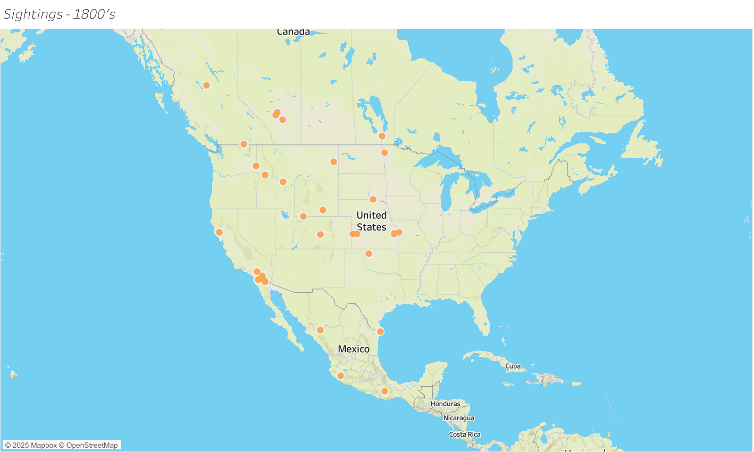
1800s: Origins & Opportunity
Open Home Range
Core populations occupied open plains and western deserts.
Data Type Evolution
Early expansion began quietly across newly altered landscapes.
Notes:
“In the 1800s, coyotes were mostly western — deserts, prairies, open habitat.
As railroads, farms, and grazing expanded, we unintentionally created new corridors and new edges.
Coyotes simply stepped into those openings.
They weren’t invading our world so much as adjusting to the one we were rapidly building around them.”

Slide 4
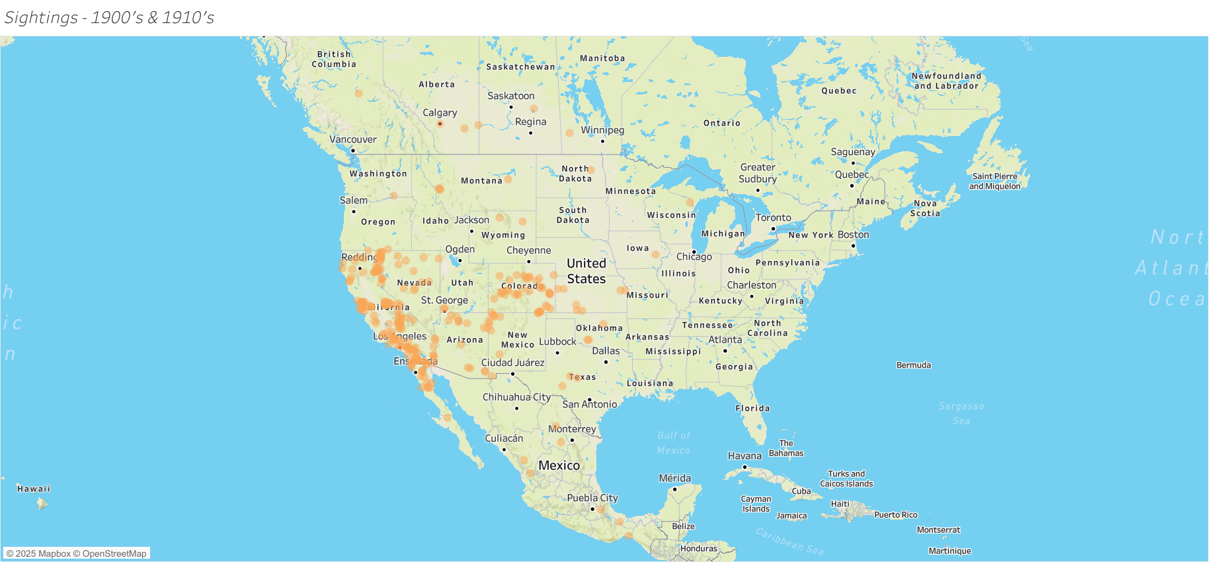
1900s: Crossing the Mississippi
First Eastern Footsteps
Verified east-of-Mississippi sightings mark the species’ first leap forward.
Great Lakes & Beyond
Records emerge in the Great Lakes and southern Canada by mid-century.
Persistence Under Fire
Gradual but persistent growth despite widespread predator control.
Notes:
“By the early 1900s, coyotes crossed the Mississippi — a symbolic line for us, but just another landscape feature for them.
Sightings spread into the Great Lakes and into Canada, even as predator control ramped up.
Their persistence isn’t just stubbornness; it’s the logical outcome of a species that can eat almost anything and live almost anywhere.
They’re not playing by our boundaries. They’re playing by ecological ones.”

Slide 5
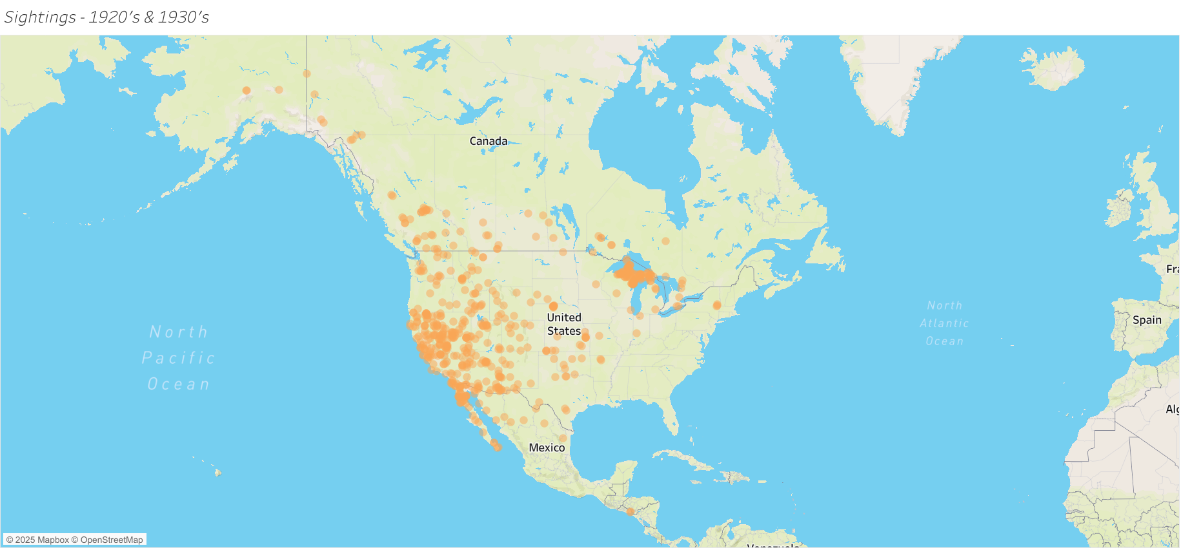
1930s: Consolidation in the West
Western Population Stronghold
Western populations stay strong even under removal programs.
Limited Eastern Presence
Scattered records begin appearing in Appalachia and the Northeast.
Onset of Eastward Expansion
Coyotes expand into flexible generalist predator roles.
Notes:
“In the 1930s, we still see a strong western core, but now with exploratory records in Appalachia and the Northeast.
These points don’t yet represent stable populations — they’re more like questions the species is asking the landscape.
Can we live here? Is there food? Is there cover?
The data tells us the answer eventually became yes.”

Slide 6
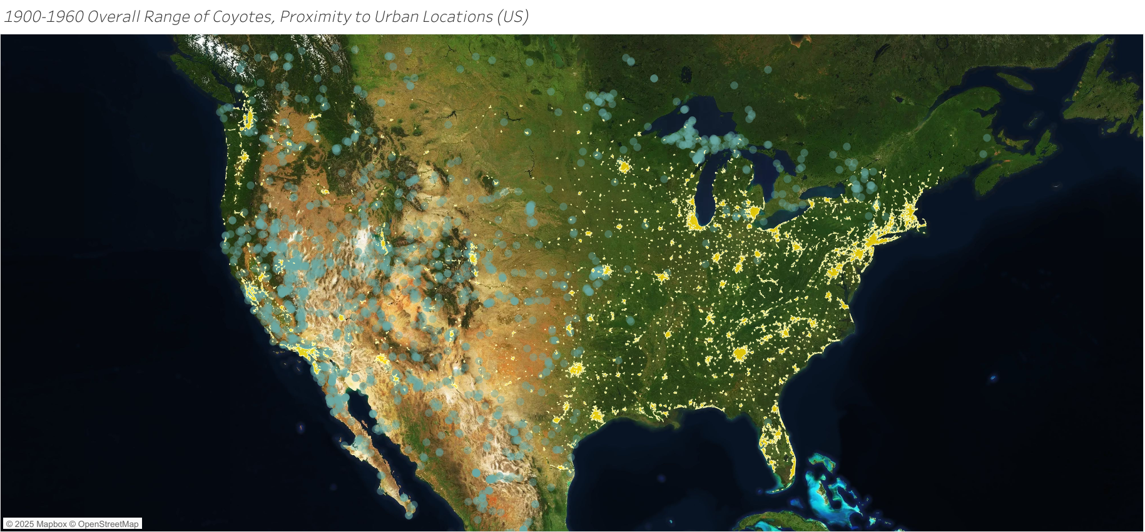
1900–1960: Early Urban Edge Dwellers
Patterns of Early Expansion
Sightings cluster near rail lines, small towns, and early suburbs.
Habitat Opportunism
Behavioral flexibility allows survival within disturbed habitats.
The Urban Pivot
Seeds of modern urban adaptation begin to appear.
Notes:
“From 1900 to 1960, coyotes begin to appear along the edges of towns and early suburbs.
They’re using rail lines, fields, and disturbed spaces — all the in-between places that don’t feel fully wild or fully human.
This is where coexistence quietly begins: not as a policy, not as a plan, but as a side effect of our own expansion.
We redraw the map, and they learn to read it faster than we do.”

Slide 8
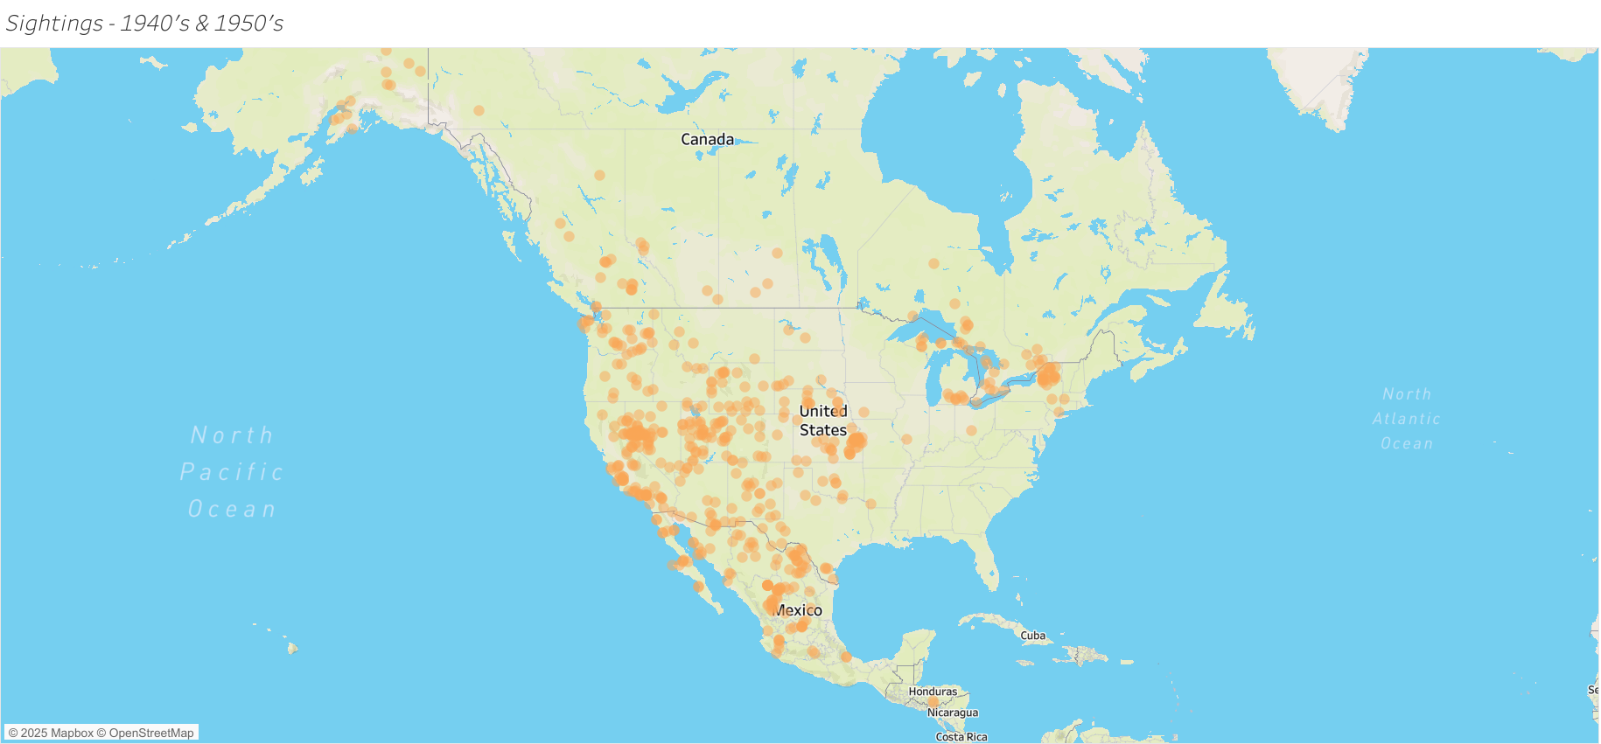
1970s–1990s: The Continental Expanse
Dominant Brush Habitat
Coyotes reach nearly every U.S. biome, from coasts to highlands.
Secondary Habitats
Populations stabilize across the Midwest, Great Lakes, and Northeast.
Ecological Context
Ecosystems rebalance as coyotes replace lost apex predators.
Notes:
“By the 1970s through the 1990s, coyotes have reached almost every major region in the United States.
They’re established in the Midwest, the Great Lakes, and the Northeast, not as visitors but as residents.
From a biological perspective, this is an incredible success story.
From a human perspective, it introduces a long list of practical questions: How do we live with a predator that’s this flexible, this mobile, and this good at being here?”

Slide 9
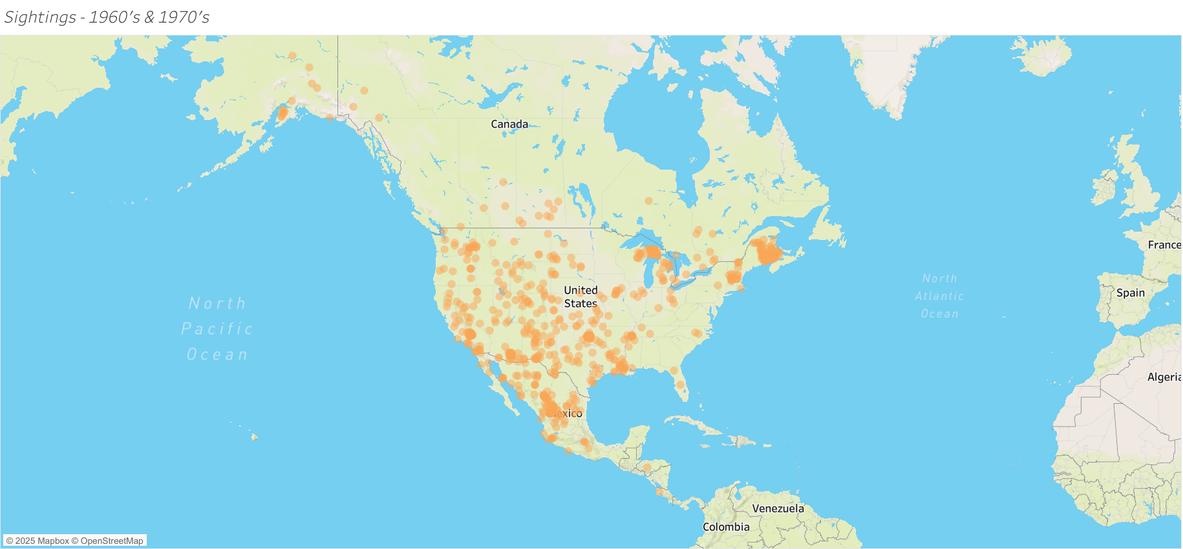
1960s/70s: NY, Alaska, Central America
From Coast to Coast
Coyotes reach nearly every U.S. biome, from coasts to highlands.
Stable but Established
Populations stabilize across the Midwest, Great Lakes, and Northeast.
New Apex, New Balance
Ecosystems rebalance as coyotes replace lost apex predators.
Notes:
“In the modern era, coyotes are firmly embedded in urban and suburban systems.
We see them on cameras, in parks, in greenbelts — not as rare events, but as part of the daily fabric of these places.
Cities, for them, are just another habitat type: food, cover, and fewer natural predators.
We often view them as out of place, but from their perspective, they’re simply surviving in the only world available, just like we are.”

Slide 10
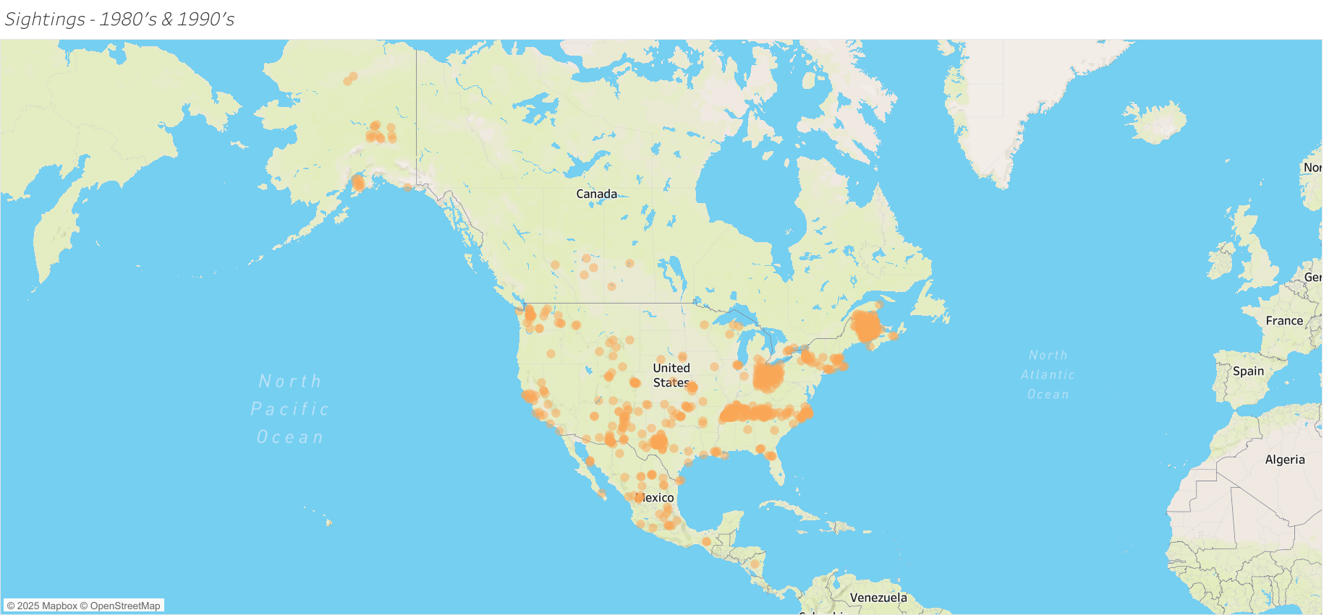
1980s/90s: Trail to the East
Early Eastern Records
Coyotes were first recorded in the Great Lakes and Northeast regions during the 1930s, marking the start of eastward expansion.
Subtle Expansion
The initial colonization was quiet but significant, showing coyote adaptation to diverse new environments.
Geographic Shift Beginning
The 1930s marked the beginning of a broader geographic shift that would accelerate in later decades.
Notes:
“When we look at sex and age structure, we see a pattern dominated by adults — typical for a territorial, long-lived species.
Juveniles are under-represented, not because they don’t exist, but because they move more and get recorded less.
Taken together, the structure tells us these populations are stable and resilient, even under constant human pressure.
In other words, our presence hasn’t broken the system — it’s forced it into a new kind of balance.”

Slide 11
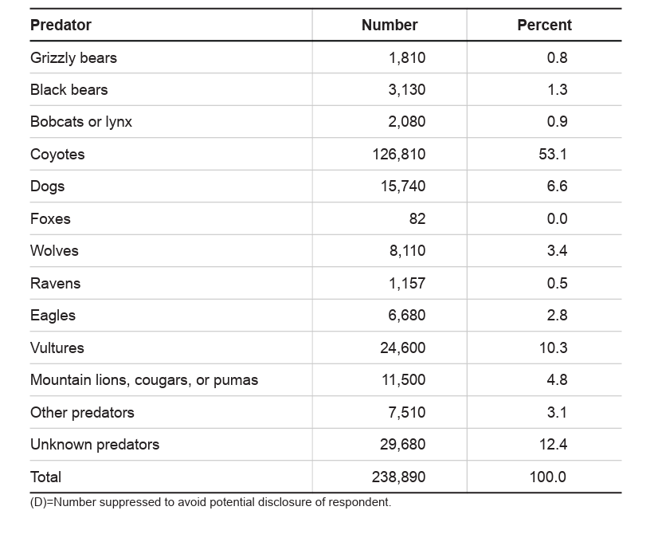
Predator at the Pasture Edge
Top Predator of Concern
Coyotes account for over half of all predator livestock losses.
Most at Risk
Sheep, calves, and goats most vulnerable in open rangelands.
Where Conflict Peaks
Conflict greatest where wildland and ranchland overlap.
https://www.aphis.usda.gov/
Notes:
“Coyotes are responsible for the majority of predator-related livestock losses.
Sheep, goats, and calves are especially vulnerable where open pasture meets wildland.
For ranchers and farmers, these aren’t statistics — they’re animals they fed, raised, and counted on.
For coyotes, this is simply accessible prey in a landscape they didn’t design.
Both sides are trying to stay alive inside the same imperfect system.”

Slide 12
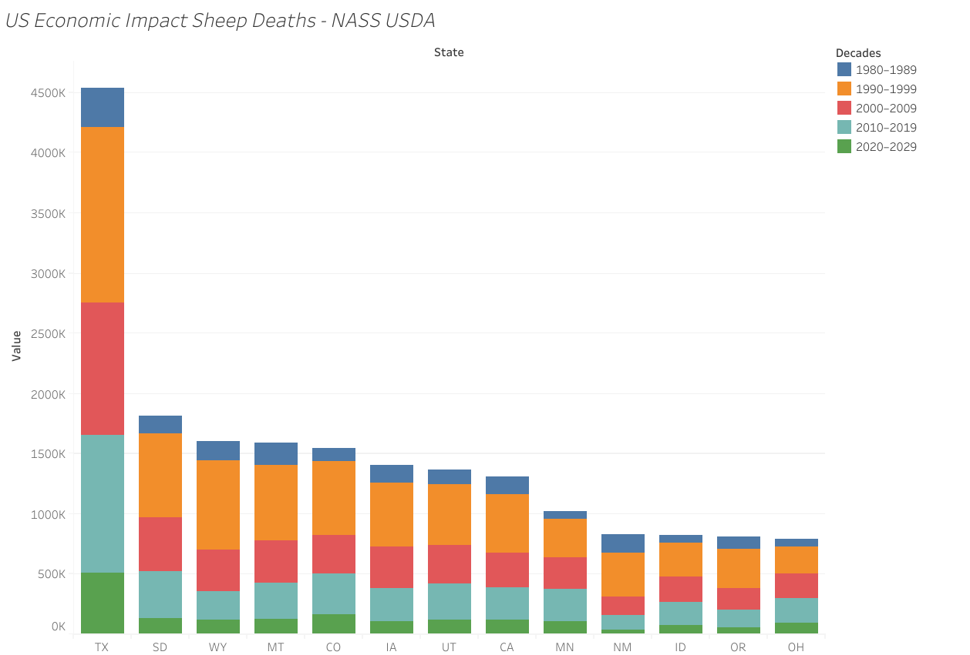
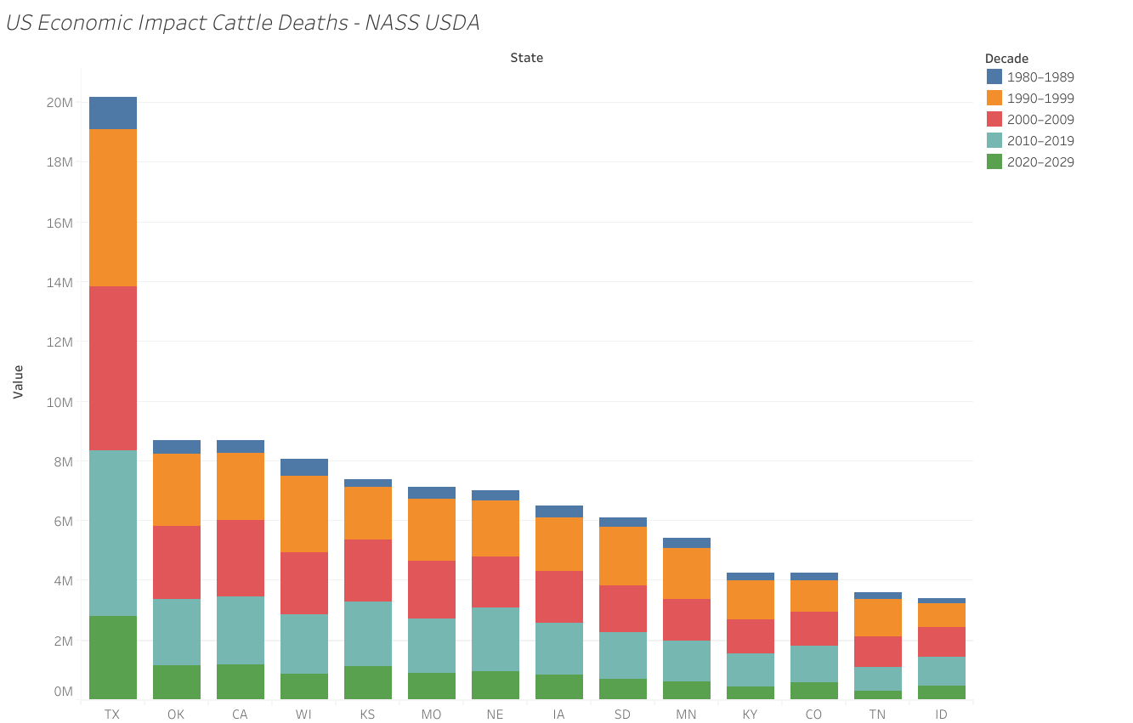
Counting the Cost Over 40 Years
Dollars on the Ground
Annual livestock losses reach tens of millions of dollars nationwide.
Regional Hotspots
Texas, Western and Mountain states sustain the highest regional costs.
Balancing Books and Beings
Highlights need for balanced coexistence and compensation strategies.
Notes:
“These losses add up to tens of millions of dollars every year, with western states hit the hardest.
Money in this context isn’t just a number — it’s mortgages, groceries, futures, stability.
So when we talk about economic impact, we’re really talking about people’s ability to keep doing the work that feeds others.
At the same time, the coyote is not acting with financial malice; it’s acting with biological necessity.
That’s the tension we’re sitting in: lives, human and non-human, depending on the same resource base.”

Slide 13
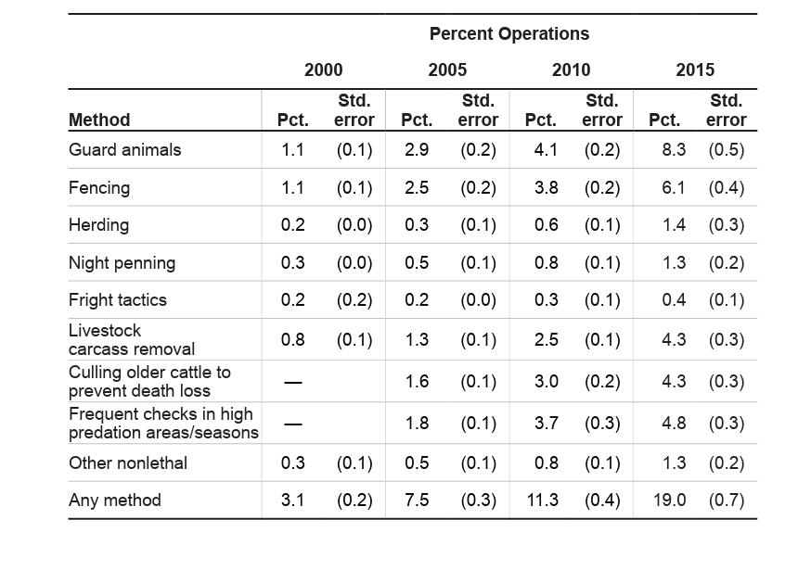
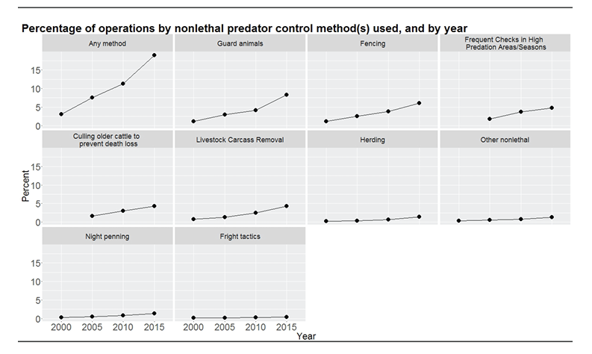
Managing Conflict 2000-2015
Shifting the Toolbox
Non-lethal deterrents increasingly replace older lethal controls.
What Works Where
Guard animals, secure fencing, and lighting gain widespread use.
No One-Size Solution
Results vary by livestock type, terrain, and regional policy.
Notes:
“Non-lethal deterrents — guard animals, fencing, lighting, and behavior-based strategies — are becoming more common because they reduce conflict without collapsing the ecosystem around it.
They protect livestock while allowing predators to exist as part of a functioning landscape.
There is no universal fix here; every place has its own mix of risk, history, and values.
But the common thread is this: good solutions acknowledge that livestock lives matter, human livelihoods matter, and wild lives matter too.”

Slide 14
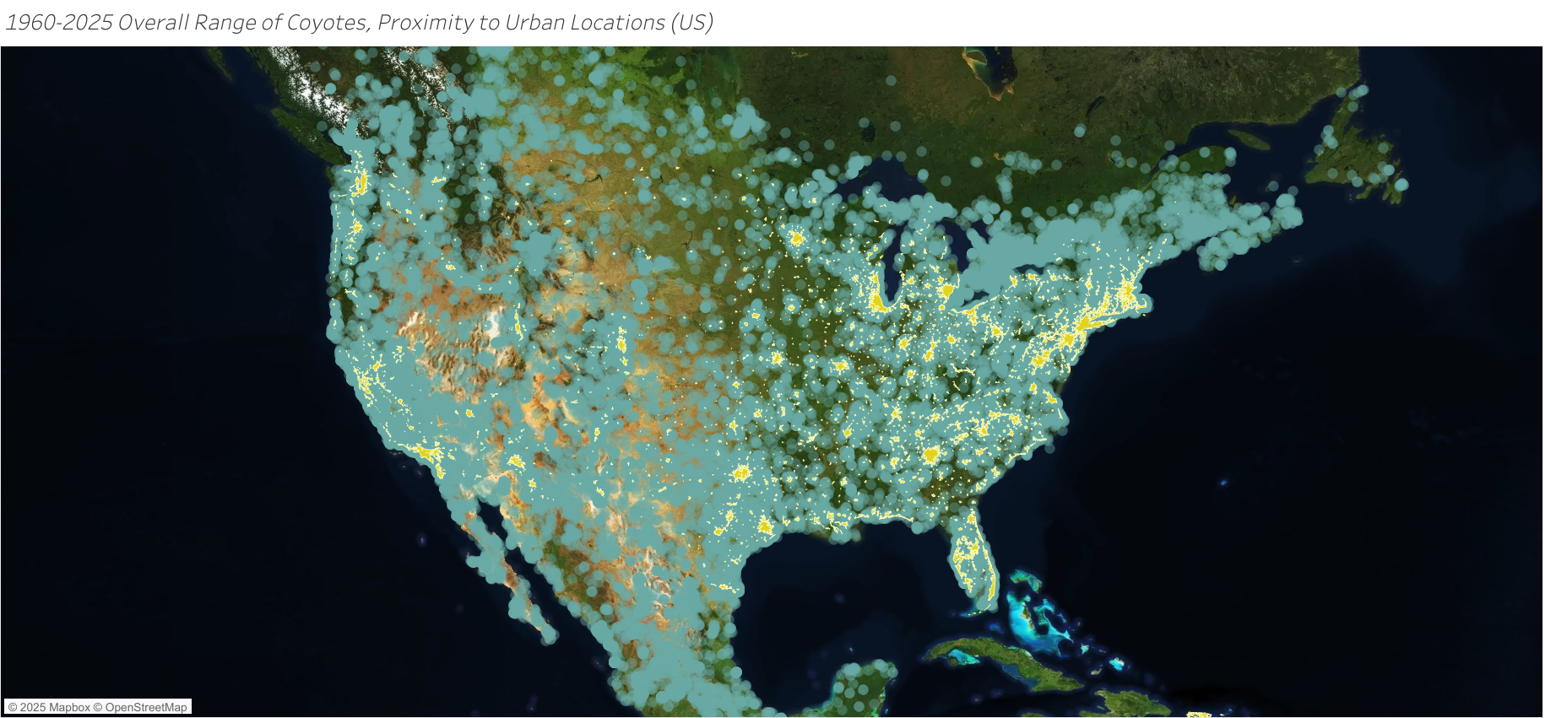
How We Know What We Know
Early Records & Specimens
Early data relied on trappers, naturalists, and museum records.
Survey Era
Late-20th-century surveys and tagging improved regional accuracy.
Real-Time Coyotes
GPS and citizen science now drive real-time wildlife mapping.
Notes:
“Our earliest data came from trappers, hunters, and museum tags — fragments of a bigger story.
Formal surveys and tagging in the late 20th century added structure to that story.
Today, GPS collars, camera traps, and citizen science give us a moving, breathing picture.
Data doesn’t solve the conflict, but it gives us enough clarity to stop guessing and start making intentional choices — for communities, for coyotes, and for the places they meet.”

Slide 15
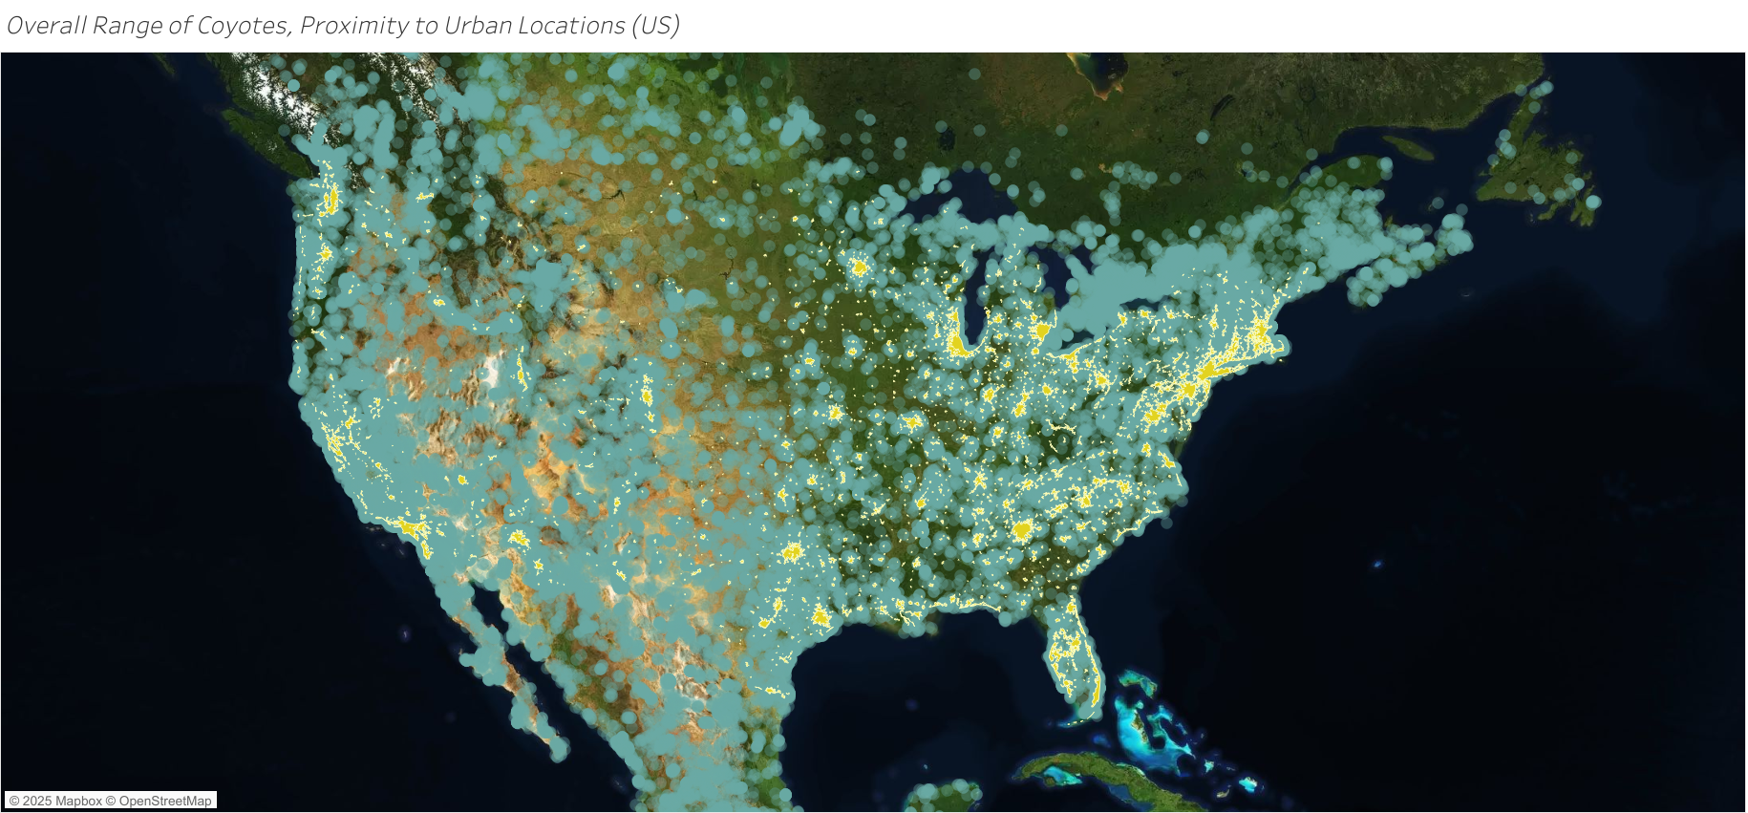
2020s: A Continental Species
Mainland North America
Confirmed in 49 states minus Hawaii and southern Canada.
Moving Southward
Expansion continues south through Central America into Panama, approaching Colombia, a transcontinental leap.
Beyond Any One Biome
Exemplifies adaptability across climates and cultural boundaries.
Notes:
“By the 2020s, coyotes are present in 49 states, Hawaii being the exception, and they’re extending into Mexico and toward Central America.
This isn’t a sudden invasion; it’s the cumulative result of two centuries of adaptation to human-shaped landscapes.
We changed the rules of the game, and they learned how to play it.
The question now isn’t *how do we undo this*, but *how do we live responsibly within it*?”

Slide 17
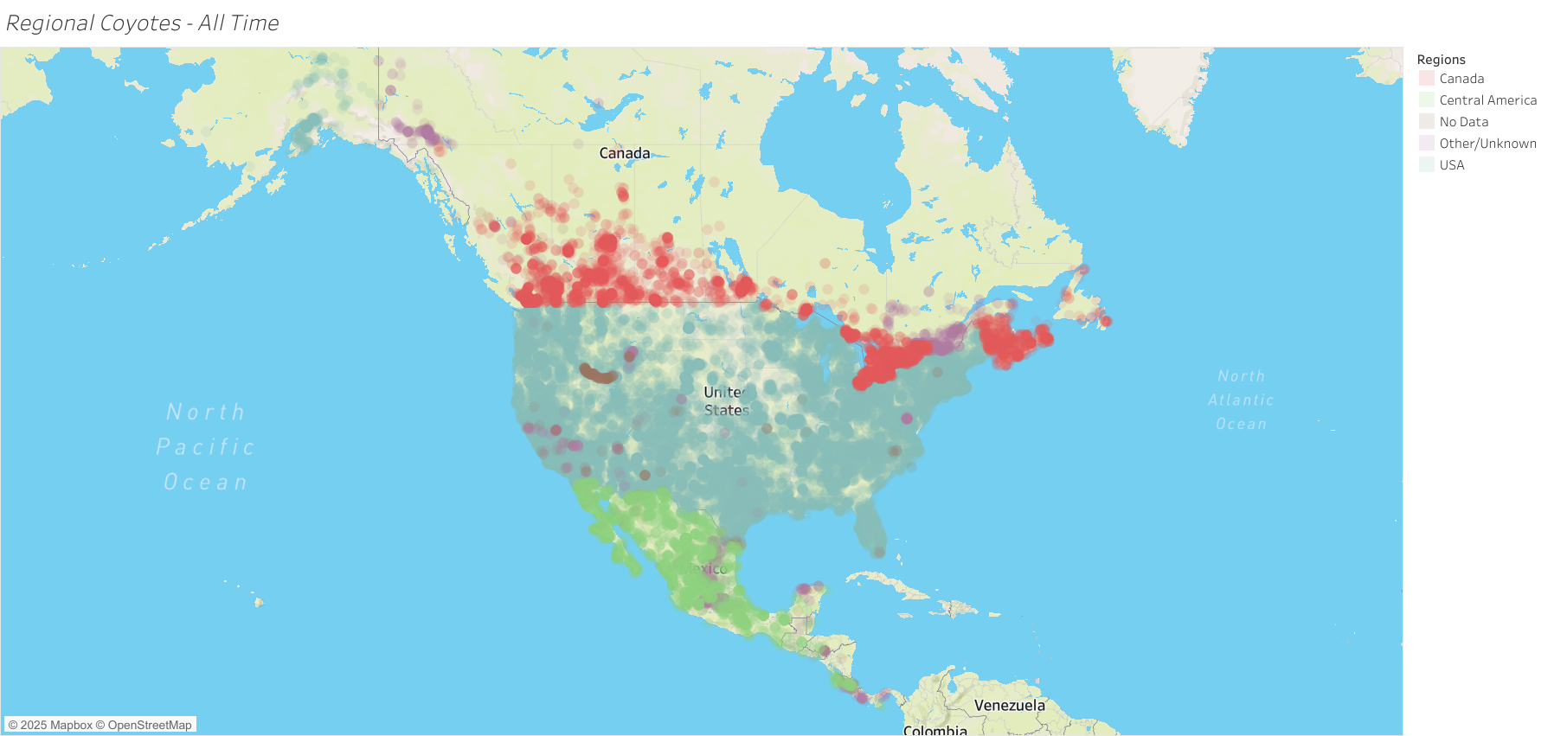
Frontiers & Corridors
New Centers of Density
Densest populations now found in the Northeast and Appalachians.
Active Edges of the Map
Alaska and Panama mark active frontiers of range expansion.
One Connected Spine
Continental corridor links North and Central American ecosystems.
Notes:
“We see dense presence in the Northeast and Appalachians, along with active movement in Alaska and down through Central America.
These emerging corridors connect regions that didn’t used to share predators in this way.
That has consequences — ecological, cultural, economic.
It’s a reminder that nothing we change in one part of the map stays local for long.
Movement is the rule, not the exception.”

Slide 18

Resilience in Real Time
Watching the Spread
Animated map visualizes two centuries of range growth and impact.
Seeing the Edges Change
Shows spread, urban presence, and changing ecological boundaries.
Coyotes in Our Image
Demonstrates resilience and adaptation in human-shaped landscapes.
Notes:
“The animation pulls everything together: slow beginnings, accelerating spread, and a final mosaic of points across the continent.
Each point represents a coyote making a choice we can’t see — to move, to stay, to risk, to survive.
At the same time, each point represents a landscape altered by us, creating the conditions that made that survival path possible.
Coyotes aren’t heroes or villains here; they’re evidence.
Evidence that resilience is real, that adaptation is messy, and that every decision we make on this land echoes through more lives than just our own.”

Slide 19

Coyote Expansion Overview

Slide 20
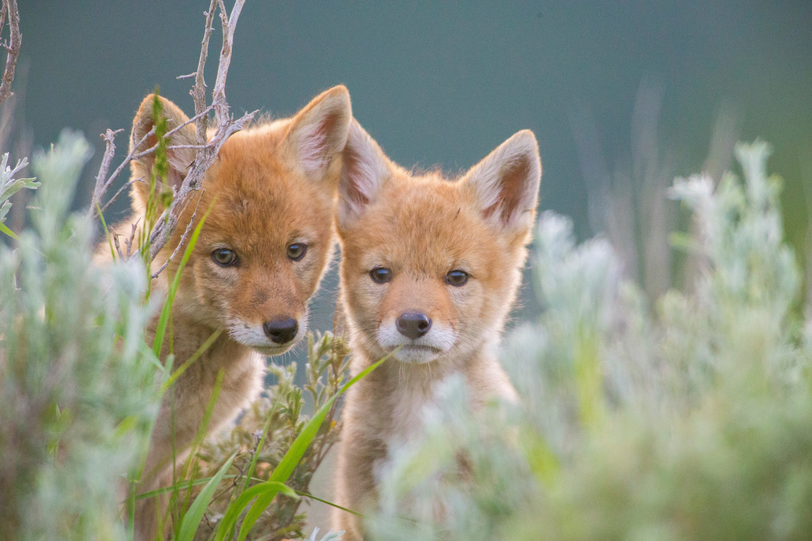
Conclusion: Coyotes as a Mirror
Historical Population Data
1930s maps reveal under-measured coyote populations limited to western regions.
Expansion and Frontier Families
Late 20th century data show rapid coyote spread and establishment of frontier family groups.
Urban Adaptation and Risks
Modern era maps highlight coyotes adapting to urban environments with new associated risks.
Ecological and Societal Reflection
Coyotes serve as indicators of land use changes and evolving data collection practices reflecting broader societal trends.

Slide 21
Early Expansion (1800s–1930s)

Slide 22
Continental Expansion (1995–2005)

Slide 23
Modern Era (2015–2025)

Slide 24
Data and Reflection

Slide 25
1900s: Crossing the Mississippi
Western Population Stronghold
DIALOGUE EXPANDING TO MICHIGAN AND EAST
Limited Eastern Presence
Coyotes had minimal presence east of the Mississippi River during this time, highlighting geographic constraints of their range.
Onset of Eastward Expansion
The 1930s marked the beginning of coyotes expanding their range eastward beyond their traditional western stronghold.

